Slide 1


REMDESIVIR
CLINICAL EVIDENCE IN COVID-19

Slide 2
Coronaviruses and COVID-19
Coronaviruses
  Range from common cold to severe disease
  Four common human coronaviruses: 229E, NL63, OC43, and HKU1
  Severe Acute Respiratory Syndrome (SARS-CoV)
  Middle East Respiratory Syndrome (MERS-CoV)
Dec 2019: 27 cases of pneumonia of unknown etiology identified in Wuhan city, China
  Causative agent identified and named SARS-CoV-2
  Disease named COVID-19 by WHO
  WHO declared COVID-19 a pandemic
WHO 2020, Hafeez et al. Eurasian J Medicine and Oncology. 2020: 4(2): 116-125; Sohrabi et al. Int J Surg. 2020 Feb 26.

Slide 3

Emergency Use Authorization of Remdesivir
EUA: EMERGENCY USE AUTHORIZATION OF REMDESIVIR
It permits the emergency use of the unapproved product remdesivir
Treatment of suspected or laboratory confirmed coronavirus disease 2019 (COVID-19) in adults and children hospitalized with severe disease.
https://www.fda.gov/media/137566/download

Slide 4
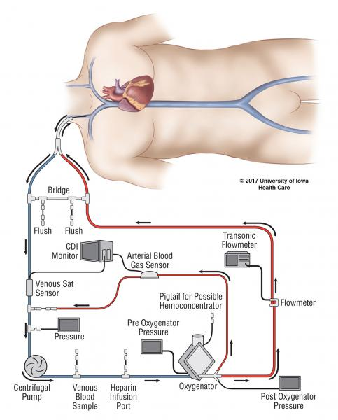
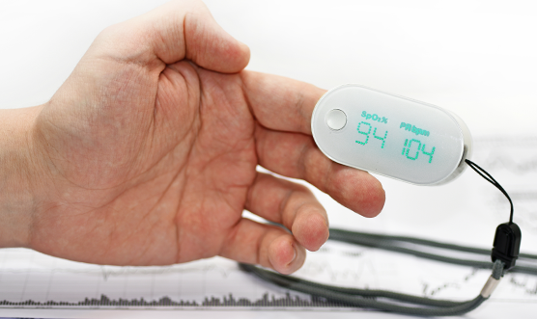
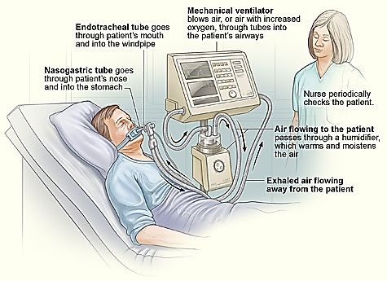
Who are patients with “severe disease” of COVID-19?
Patients with an oxygen saturation (SpO2) ≤ 94% on room air or
Requiring supplemental oxygen or
Requiring mechanical ventilation or
Requiring extracorporeal membrane oxygenation (ECMO)
https://www.fda.gov/media/137566/download

Slide 5
Remdesivir: Global Perspectives
Japanese Ministry of Health, Labour and Welfare approved remdesivir as a treatment for SARS-CoV-2 infection, referencing the United States’ FDA EUA^{[1,2]}
The EMA human medicines committee has recommended expanding the compassionate use recommendations for remdesivir to treat patients with COVID-19 in Europe^{[3]}
  In addition to treatment of patients undergoing mechanical ventilation, the recommendation now includes treatment of hospitalized patients requiring supplemental oxygen, noninvasive ventilation, high-flow oxygen devices, or ECMO
1. https://www.gilead.com/news-and-press/press-room/press-releases/2020/5/gilead-announces-approval-of-veklury-remdesivir-in-japan-for-patients-with-severe-covid19. 2. Remdesivir EUA Provider Fact Sheet. 3. EMA Summary of Compassionate Use: Remdesivir.

Slide 6
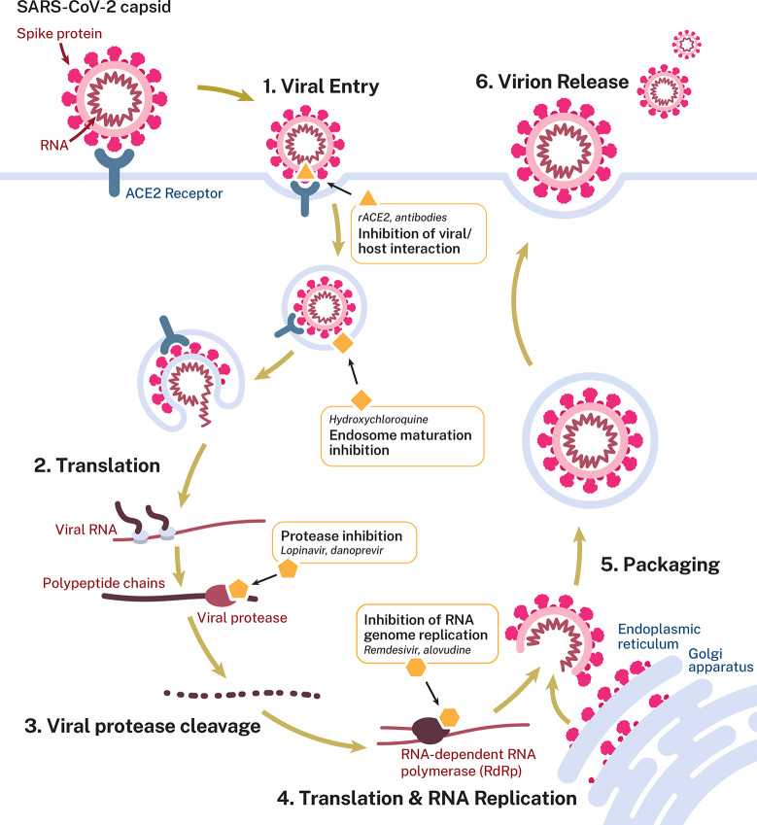
Potential targets and postulated mechanism of action for antiviral interventions

Slide 7
COVID-19 Therapies Predicted to Provide Benefit at Different Stages
Stage I
(Early Infection)
Stage II
(Pulmonary Phase)
Stage III
(Hyperinflammation Phase)
IIA
IIB
Viral Response Phase
Severity of Illness
Host Inflammatory Response Phase
Benefit demonstrated
Time Course
Clinical symptoms
Mild constitutional symptoms
Fever > 99.6°F
Dry cough
Shortness of breath without (IIA) and with hypoxia (IIB) (PaO₂/FiO₂ ≤ 300 mm Hg)
ARDS
SIRS/shock
Cardiac failure
Benefit unclear
Clinical signs
Lymphopenia
Abnormal chest imaging
Transaminitis
Low-normal procalcitonin
Elevated inflammatory markers
(CRP, LDH, IL-6, D-dimer, ferritin)
Troponin, NT-proBNP elevation
Remdesivir
Dexamethasone
Oxygen
Siddiqi. J Heart Lung Transplant. 2020;39:405.

Slide 8
Adaptive COVID-19 Treatment Trial (NIAID ACTT-1): Study Design
Multicenter, adaptive, randomized, double-blind, placebo-controlled phase III trial
Day 10
Adult patients ≥ 18 yrs of age; hospitalized with symptoms of
COVID-19/SARS-CoV-2 infection and
≥ 1 of following: radiographic infiltrates by imaging; SpO₂ ≤ 94% on room air; requiring supplemental oxygen; or requiring mechanical ventilation
(N = 1063)
Daily assessment to Day 29 for time to clinical improvement while hospitalized;
if discharged, assessments at Days 15, 22, and 29
Remdesivir IV QD
Day 1 200 mg ; D2-D10 100 mg
Placebo IV QD
Primary endpoint: time to recovery* by Day 29 according to ordinal scale
Secondary endpoints: treatment-related improvements in 8-point ordinal scale at Day 15
*Day of recovery is first day patient satisfies 1 of these categories from ordinal scale: 1) hospitalized, not requiring supplemental oxygen, no longer requires ongoing medical care; 2) not hospitalized, limitation on activities and/or requiring home oxygen; or 3) not hospitalized, no limitations on activities.
Beigel. NEJM. 2020;[Epub]. NCT04280705.

Slide 9
NIAID ACTT-1: Clinical Status Ordinal Scale
Clinical Status Ordinal Scale | Clinical Status Description for Assessment
1 | Not hospitalized, no limitations on activities
2 | Not hospitalized, limitation on activities, and/or requiring home oxygen
3 | Hospitalized, not requiring supplemental oxygen and no longer requires ongoing medical care (if hospitalization extended for infection-control purposes)
4 | Hospitalized, not requiring supplemental oxygen; requiring ongoing medical care (COVID-19 related or otherwise)
5 | Hospitalized, requiring supplemental oxygen
6 | Hospitalized, on noninvasive ventilation or high-flow oxygen devices
7 | Hospitalized, on invasive mechanical ventilation or ECMO
8 | Death
Beigel. NEJM. 2020;[Epub].

Slide 10
NIAID ACTT-1 : Patient Baseline Characteristics
Characteristic | All (N = 1063) | Remdesivir (n = 541) | Placebo (n = 522)
Mean age, yrs (SD) | 58.9 (15.0) | 58.6 (14.6) | 59.2 (15.4)
Male sex, n (%) | 684 (64.3) | 352 (65.1) | 332 (63.6)
Median time from symptom onset to randomization, days* (IQR) | 9 (6-12) | 9 (6-12) | 9 (7-13)
Number of comorbidities, n/N (%) 0 1 ≥ 2 | 193/920 (21.0) 248/920 (27.0) 479/920 (52.1) | 91/467 (19.5) 131/467 (28.1) 245/467 (52.5) | 102/453 (22.5) 117/453 (25.8) 234/453 (51.7)
Comorbidities, n/N (%) Hypertension Obesity Type II Diabetes | 460/928 (49.6) 342/925 (37.0) 275/927 (29.7) | 231/469 (49.3) 177/469 (37.7) 144/470 (30.6) | 229/459 (49.9) 165/456 (36.2) 131/457 (28.7)
*As of April 28, 2020, symptom onset data were missing for 15 patients; coexisting conditions data
were missing for 133 patients and were incomplete for 10 patients.
Beigel. NEJM. 2020;[Epub]

Slide 11
NIAID ACTT-1 : Baseline Ordinal Score
Ordinal Scale Score, n (%) | All (N = 1063) | Remdesivir (n = 541) | Placebo (n = 522)
4 - Hospitalized, not requiring supplemental oxygen, requiring ongoing medical care* | 127 (11.9) | 67 (12.4) | 60 (11.5)
5 - Hospitalized, requiring supplemental oxygen | 421 (39.6) | 222 (41.0) | 199 (38.1)
6 - Hospitalized, receiving noninvasive ventilation or high-flow oxygen devices | 197 (18.5) | 98 (18.1) | 99 (19.0)
7 - Hospitalized, receiving invasive mechanical ventilation or ECMO | 272 (25.6) | 125 (23.1) | 147 (28.2)
Baseline score missing | 46 (4.3) | 29 (5.4) | 17 (3.3)
*COVID-19-related or otherwise.
Beigel. NEJM. 2020;[Epub]

Slide 12
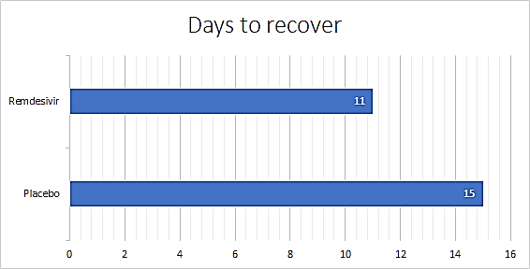
NIAID ACTT-1 : Results
Preliminary results from 1059 patients
Results also suggested a
survival benefit
31%
30%
Faster recovery
Median time to recovery
Remdesivir
11 days
p<0.001
7.1%
Mortality
p=NS
Placebo
15 days
11.9%
Days
By 14 days
Serious AEs: 21.1% (114/541) with remdesivir and 27.0% (141/522) with placebo
Grade 3 or 4 adverse events occurred in 156 patients (28.8%) in the remdesivir group and in 172 in the placebo group (33.0%)
John H. Beigel et al. N Engl J Med . 2020 May 22
Notes:
Grade 3 or 4 adverse events occurred in 156 patients (28.8%) in the remdesivir group and in 172 in the placebo group (33.0%) (Table S4). The most common adverse events in the remdesivir group were anemia or decreased hemoglobin (43 events [7.9%], as compared with 47 [9.0%] in the placebo group); acute kidney injury, decreased estimated glomerular filtration rate or creatinine clearance, or increased blood creatinine (40 events [7.4%], as compared with 38 [7.3%]); pyrexia (27 events [5.0%], as compared with 17 [3.3%]); hyperglycemia or increased blood glucose level (22 events [4.1%], as compared with 17 [3.3%]); and increased aminotransferase levels including alanine aminotransferase, aspartate aminotransferase, or both (22 events [4.1%], as compared with 31 [5.9%]). Otherwise, the incidence of adverse events was not found to be significantly different between the remdesivir group and the placebo group.

Slide 13
NIAID ACTT-1: Subgroup Analysis of Time to Recovery
Subgroup
Patients, n
Recovery Rate Ratio (95% CI)
All patients
Geographic region
North America
Europe
Asia
Race
White
Black
Asian
Other
Ethnic group
Hispanic or Latino
Not Hispanic or Latino
Age
18 to < 40 yrs
40 to < 65 yrs
≥ 65 yrs
Sex
Male
Female
Symptoms duration
≤ 10 days
> 10 days
Baseline ordinal score
4 (not receiving oxygen)
5 (receiving oxygen)
6 (receiving high-flow oxygen or noninvasive mechanical ventilation)
7 (receiving mechanical ventilation or ECMO)
1059
844
163
52
563
219
134
143
247
748
119
558
382
682
377
664
380
127
421
197
272
1.32 (1.12-1.55)
1.33 (1.11-1.59)
1.40 (0.90-2.16)
1.20 (0.65-2.22)
1.39 (1.12-1.73)
1.14 (0.81-1.61)
1.04 (0.68-1.57)
1.89 (1.15-3.10)
1.23 (0.88-1.72)
1.33 (1.10-1.61)
2.03 (1.31-3.15)
1.16 (0.94-1.44)
1.37 (1.02-1.83)
1.31 (1.07-1.59)
1.38 (1.05-1.81)
1.28 (1.05-1.57)
1.38 (1.05-1.81)
1.38 (0.94-2.03)
1.47 (1.17-1.84)
1.20 (0.79-1.81)
0.95 (0.64-1.42)
0.5
1.0
2.0
3.0
4.0
Placebo Better
Remdesivir Better
Beigel. NEJM. 2020;[Epub]

Slide 14
SIMPLE Clinical Trial: Severe COVID-19
Multicenter, a randomized, open-label, phase 3 trial
Remdesivir IV QD
Day 1 200 mg ; D2-D5 100 mg
At least 12 years of age; hospitalized patients with confirmed SARS-CoV-2 infection, oxygen saturation of 94% or less
while they were breathing ambient air, and radiologic evidence of pneumonia.
(N = 397)
Remdesivir IV QD
Day 1 200 mg ; D2-D10 100 mg
Primary endpoint: Clinical status assessed on day 14 on a 7-point ordinal scale
Secondary endpoints: proportion of patients with adverse events after the first dose of remdesivir for up to 30 days after the last dose
Jason D. Goldman et al. NEJM May 27, 2020

Slide 15
SIMPLE Clinical Trial: Results
At 14 days
Time to clinical improvement
Clinical improvement
Clinical recovery
Mortality
10 days
64%
64%
8%
Remdesivir 5-days
11 days
54%
54%
11%
Remdesivir 10-days
Jason D. Goldman et al. NEJM May 27, 2020
Notes:
Clinical improvement was defined as an improvement of two or more points from baseline on a predefined 7-point scale, ranging from hospital discharge to increasing levels of oxygen support to death. Patients achieved clinical recovery if they no longer required oxygen support or were discharged from the hospital.
https://www.nejm.org/doi/full/10.1056/NEJMoa2015301

Slide 16
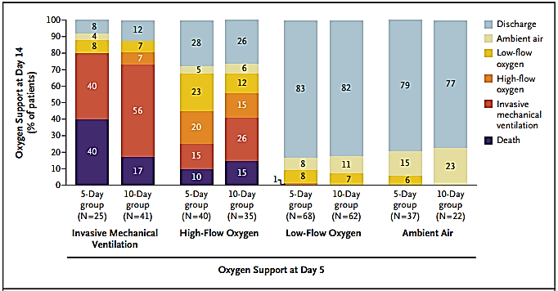
Oxygen Support on Day 14
Among patients receiving mechanical ventilation or ECMO at day 5, 40% (10 of 25) in the 5-day group had died by day 14, as compared with 17% (7 of 41) in the 10-day group
Jason D. Goldman et al. NEJM May 27, 2020

Slide 17
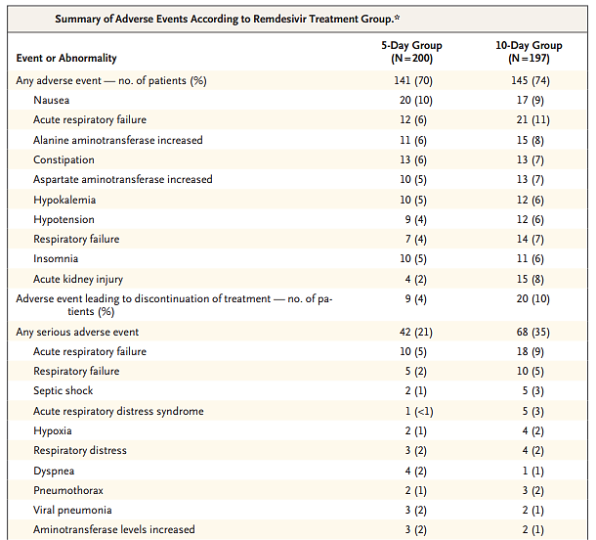
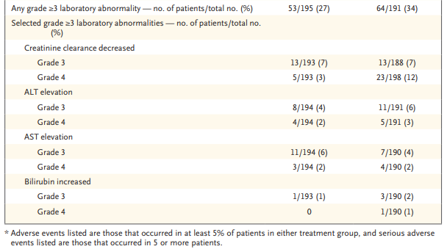
Safety

Slide 18
SIMPLE-Moderate Study:
Remdesivir in Patients With Moderate COVID-19
Multicenter, randomized, open-label phase III trial
Primary endpoint: improvement on 7-point ordinal scale on Day 11
Secondary endpoint: treatment-emergent adverse events
Remdesivir IV QD
Day 1 200 mg; Days 2-5 100 mg
(n = 191)
Patients ≥ 12 yrs of age; hospitalized with SARS-CoV-2 infection confirmed by RT-PCR; radiographic infiltrates by imaging; SpO₂ > 94% on room air
(N = 584)
Remdesivir IV QD
Day 1 200 mg; Days 2-10 100 mg
(n = 193)
Standard of Care
(n = 200)
Christoph D. Spinner et al. JAMA . 2020 Aug 21;e2016349

Slide 19
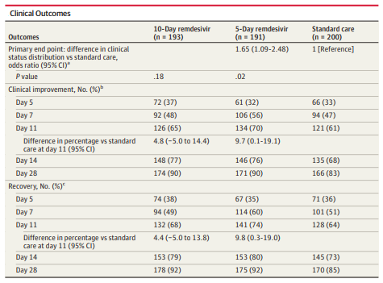
SIMPLE-Moderate Study: Efficacy
On day 11, patients in the 5-day remdesivir group had statistically significantly higher odds of a better clinical status distribution than those receiving standard care (odds ratio, 1.65; 95% CI, 1.09-2.48; P = .02)
The clinical status distribution on day 11 between the 10-day remdesivir and standard care groups was not significantly different (P = .18 by Wilcoxon rank sum test).
Christoph D. Spinner et al. JAMA . 2020 Aug 21;e2016349

Slide 20
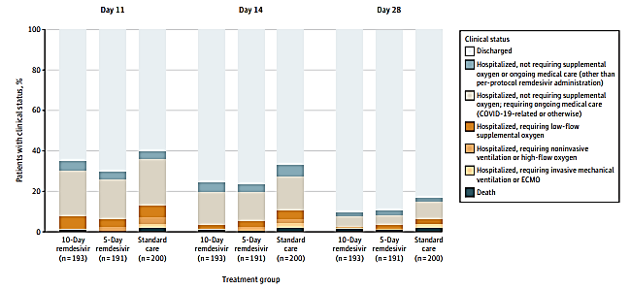
Clinical Status on a 7-Point Ordinal Scale on Study Days 11, 14, and 28 by Treatment Group
Christoph D. Spinner et al. JAMA . 2020 Aug 21;e2016349

Slide 21
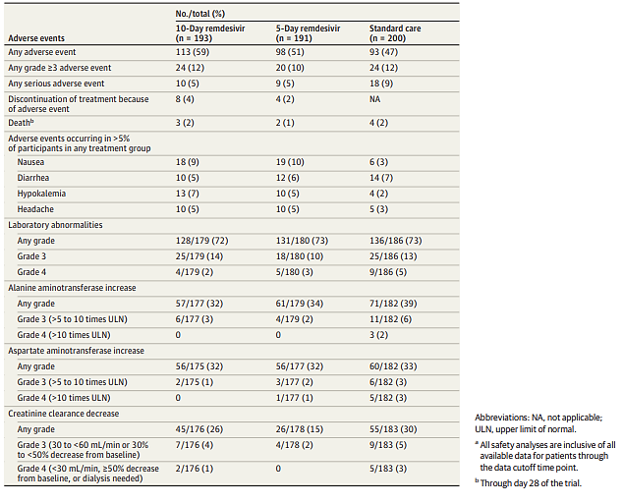
Adverse Event Summary
Christoph D. Spinner et al. JAMA . 2020 Aug 21;e2016349

Slide 22
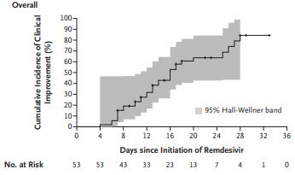
Compassionate Use: Severe Covid-19
Compassionate Use of Remdesivir
61 patients with severe COVID-19
Patients received a 10-day course of remdesivir
Improvement in oxygen-support class
68%
Discharged
47%
Deaths
13%
Jonathan Grein et al. N Engl J Med. 2020 Apr 10
Notes:
During a median follow-up of 18 days
In addition, we evaluated the proportion of patients with clinical improvement, as defined by live discharge from a decrease of at least 2 points from baseline on a modified ordinal scale (as recommended by the WHO R&D Blueprint Group), or both
The six-point scale consists of the following categories: 1, not hospitalized; 2, hospitalized, not requiring supplemental oxygen; 3, hospitalized, requiring supplemental oxygen; 4, hospitalized, requiring nasal high-flow oxygen therapy, noninvasive mechanical ventilation, or both; 5, hospitalized, requiring invasive mechanical ventilation, ECMO, or both; and 6, death.

Slide 23
Overall safety summary
Graded elevations in ALT and AST have been observed ,the mechanism of these elevations is unknown
Patients should have appropriate clinical and laboratory monitoring to aid in early detection of any potential adverse events.
https://www.fda.gov/media/137566/download

Slide 24
REMDESIVIR
Notes:
Mechanism of action
Remdesivir triphosphate acts as an analog of adenosine triphosphate (ATP) and competes with the natural ATP substrate for incorporation into nascent RNA chains by the SARS-CoV-2 RNA-dependent RNA polymerase, which results in delayed chain termination during replication of the viral RNA.

Slide 25
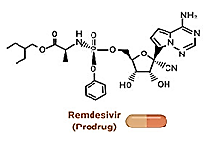
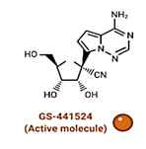
Remdesivir: Mechanism of action
Notes:
Mechanism of action
Remdesivir triphosphate acts as an analog of adenosine triphosphate (ATP) and competes with the natural ATP substrate for incorporation into nascent RNA chains by the SARS-CoV-2 RNA-dependent RNA polymerase, which results in delayed chain termination during replication of the viral RNA.

Slide 26
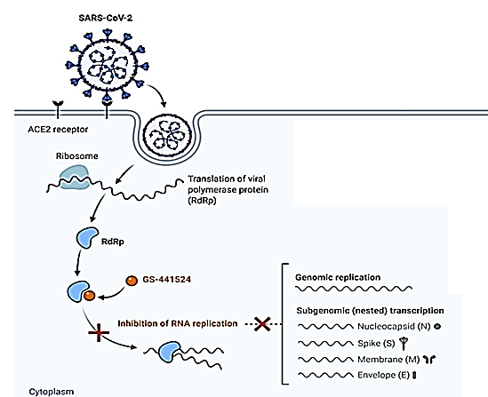
Remdesivir: Mechanism of action
Remdesivir: nucleoside ribonucleic acid (RNA) polymerase inhibitor
Notes:
Mechanism of action
Remdesivir triphosphate acts as an analog of adenosine triphosphate (ATP) and competes with the natural ATP substrate for incorporation into nascent RNA chains by the SARS-CoV-2 RNA-dependent RNA polymerase, which results in delayed chain termination during replication of the viral RNA.

Slide 27
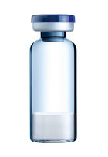
Remdesivir: How supplied
100 mg
Preservative-free white to off-white to yellow lyophilized powder
Single-dose vial
Remdesivir vial
https://www.fda.gov/media/137566/download

Slide 28
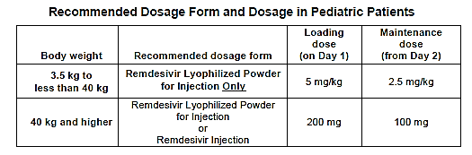
Dosage
Recommended Dosage in Adult Patients
The recommended dosage in adults is a single loading dose of remdesivir 200 mg on Day 1 followed by once-daily maintenance doses of remdesivir 100 mg from Day 2 via IV infusion.
Recommended Dosage in Pediatric Patients*
For pediatric patients weighing 3.5 kg to less than 40 kg, use remdesivir for injection, 100 mg, lyophilized powder only
*Dosage in Pediatric based on Physiologically-based pharmacokinetics (PBPK)

Slide 29

Remdesivir dosage
Adult patients with severe disease
YES
Requiring invasive mechanical ventilation and/or ECMO
NO
Day 1
200 mg
Day 1
200 mg
Day 2-10
100 mg each day
Day 2-5
100 mg each day
10-day treatment
5-day treatment
Total Vials = 11
Total Vials = 6
https://www.fda.gov/media/137566/download

Slide 30
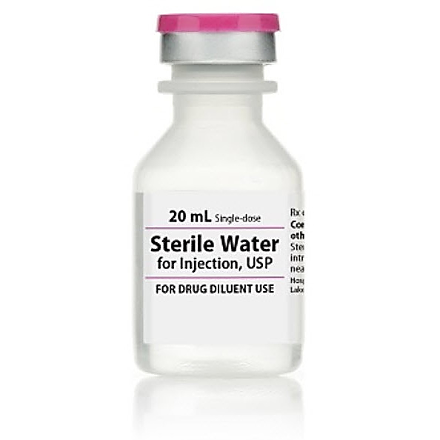
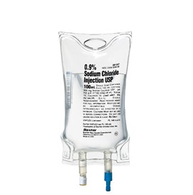
Adult dose preparation
1
2
3
4
5
+
Remdesivir
100 mg
Lyophilized
Powder
Reconstitute with 19 ml sterile water for injection
Dilute with 0.9 % saline
Ready to infuse
Shake the vial for 30 seconds
contents of the vial to settle for 2 to 3 minutes
https://www.fda.gov/media/137566/download

Slide 31
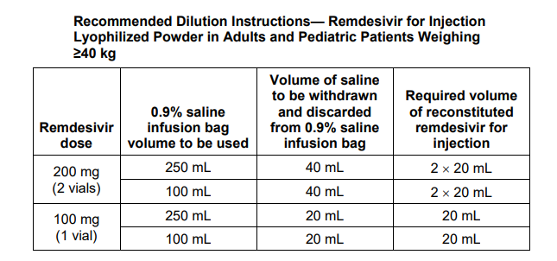
Dilution
Adults and Pediatric Patients Weighing ≥ 40 kg

Slide 32
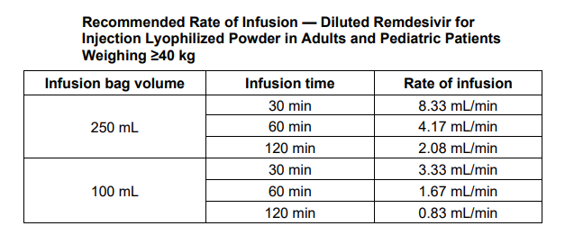
Rate of Infusion
Adults and Pediatric Patients Weighing ≥ 40 kg

Slide 33
Dilution
Pediatric Patients Weighing 3.5 Kg < 40 kg
Dilution Instructions
Following reconstitution as instructed above, each vial will contain a 100 mg/20 mL (5 mg/mL) remdesivir concentrated solution.
For pediatric patients weighing 3.5 kg to less than 40 kg, the 100 mg/20 mL (5 mg/mL) remdesivir concentrate should be further diluted to a fixed concentration of 1.25 mg/mL using 0.9% sodium chloride.
The total required infusion volume of the 1.25 mg/mL remdesivir solution for infusion is calculated from the pediatric weight-based dosing regimens of 5 mg/kg for the Loading Dose and 2.5 mg/kg for each Maintenance Dose.
Small 0.9% sodium chloride infusion bags (e.g., 25, 50, or 100 mL) or an appropriately sized syringe should be used for pediatric dosing.
The recommended dose is administered via IV infusion in a total volume dependent on the dose to yield the target remdesivir concentration of 1.25 mg/mL.

Slide 34
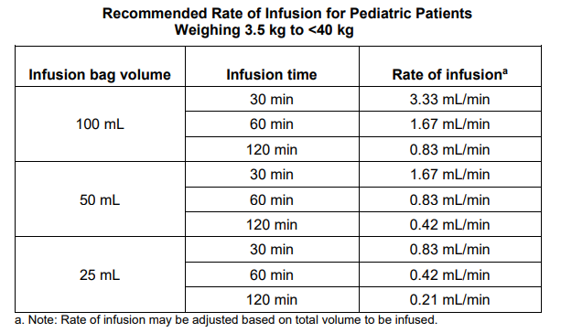
Rate of Infusion
Pediatric Patients Weighing 3.5 Kg < 40 kg

Slide 35

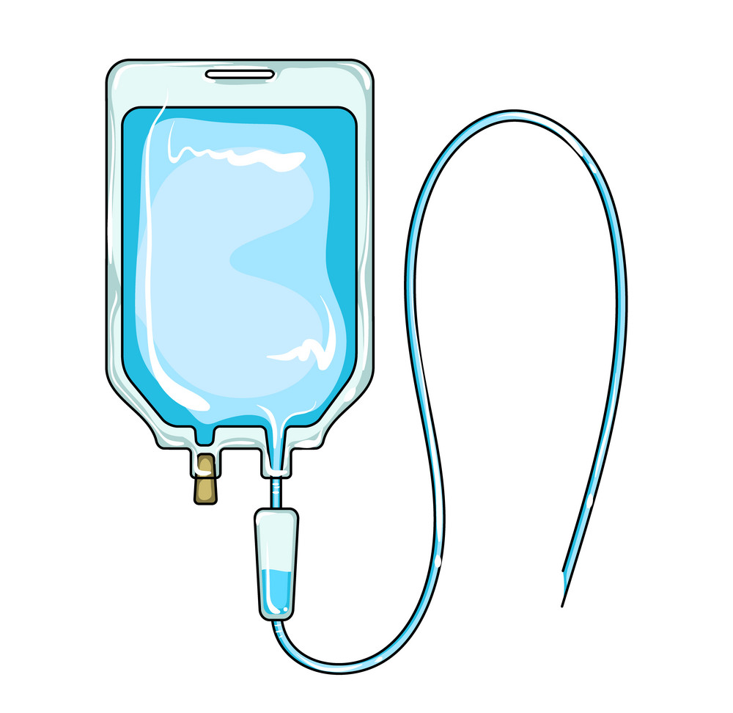
Administration
Infused intravenously over
30 to 120 minutes
https://www.fda.gov/media/137566/download

Slide 36
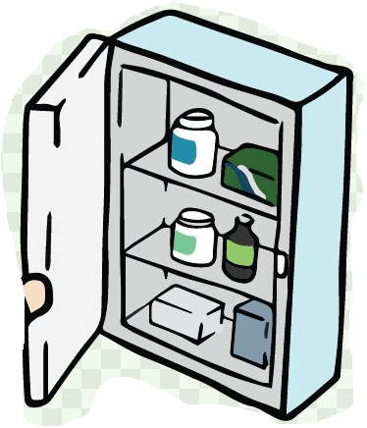
Storage
Lyophilized Powder
Lyophilized Powder
Store remdesivir for injection, 100 mg, vials below 30°C until required for use.
Reconstituted solution
After reconstitution, vials can be stored up to 4 hours at room temperature (20°C to 25°C [68°F to 77°F]) prior to administration or 24 hours at refrigerated temperature (2°C to 8°C [36°F to 46°F]).
Diluted Infusion Solution
Store diluted remdesivir solution for infusion up to 4 hours at room temperature (20°C to 25°C [68°F to 77°F]) or 24 hours at refrigerated temperature (2°C to 8°C [36°F to 46°F]).

Slide 37
WARNINGS AND PRECAUTIONS
Increased Risk of Transaminase Elevations
Transaminase elevations have also been reported in patients with COVID-19 who received remdesivir in clinical trials.
As transaminase elevations have been reported as a component of COVID-19, including in patients receiving placebo in clinical trials of remdesivir, discerning the contribution of remdesivir to transaminase elevations in this patient population is challenging.
Hepatic laboratory testing should be performed in all patients prior to starting remdesivir and daily while receiving remdesivir.
Remdesivir should not be initiated in patients with ALT greater than or equal to 5 times the upper limit of normal at baseline.
Remdesivir should be discontinued in patients who develop:
  ALT greater than or equal to 5 times the upper limit of normal during treatment with remdesivir. Remdesivir may be restarted when ALT is less than 5 times the upper limit of normal.
  OR
  ALT elevation accompanied by signs or symptoms of liver inflammation or increasing conjugated bilirubin, alkaline phosphatase, or INR.

Slide 38
WARNINGS AND PRECAUTIONS
Risk of Reduced Antiviral Activity When Coadministered with Chloroquine or Hydroxychloroquine
Coadministration of remdesivir and chloroquine phosphate or hydroxychloroquine sulfate is not recommended based on in vitro data demonstrating an antagonistic effect of chloroquine on the intracellular metabolic activation and antiviral activity of remdesivir

Slide 39
DRUG INTERACTIONS
In vitro, remdesivir is a substrate for drug metabolizing enzymes CYP2C8, CYP2D6, and CYP3A4, and is a substrate for Organic Anion Transporting Polypeptides 1B1 (OATP1B1) and P-glycoprotein (P-gp) transporters. In vitro, remdesivir is an inhibitor of CYP3A4, OATP1B1, OATP1B3, BSEP, MRP4, and NTCP. The clinical relevance of these in vitro assessments has not been established.

Slide 40
Summary
EUA by US FDA: Remdesivir is authorized for emergency use by healthcare providers for the treatment of suspected or laboratory-confirmed COVID-19 in all hospitalized adult and pediatric patients, irrespective of their severity of disease
Severe patients on remdesivir recovered 30 % faster as compared to placebo, with a trend towards survival benefit
5 days’ treatment is adequate for subgroups shown so far to respond to remdesivir
Pending further trial results in critical illness, 10 days if mechanical ventilation, ECMO
In moderate disease, 5-day remdesivir group had statistically significantly higher odds of a better clinical status distribution than those receiving standard care (odds ratio, 1.65; 95% CI, 1.09-2.48; P = .02)
Overall, well tolerated

Slide 41
Thank you

